Slide 1
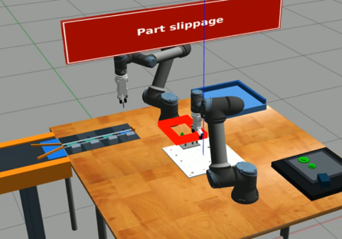
Part slippage: recovery outline proposed by the LLM
gpt-5.4, reasoning effort medium, every check off · run of 20 Oct 2026 · 4 recovery events, 8 LLM calls, 243 s
fault
new recovery event (not in the nominal models)
nominal event
issue found in review
FAULT
1
2
3
4
HANDOFF
NOMINAL EVENTS THAT CONNECT TO THE PLAN
ur5e-4
faulted
×
retract home
clear fault
gear_small
dropped
!
ur5e-3
place KET4
in buffer zone_1
pick gear_small
from drop pose
assemble gear_small
on assembly board
move_home
pick_approach
KET4
pick_grasp
KET4
remaining
plan
Buffer
zone_1 ← KET4
connected
Failure
What the LLM created
4 new events, none in the nominal models
ur5e-3 parks KET4 in the Buffer, picks up gear_small, and assembles it
Then nominal work resumes: ur5e-3 picks KET4 again
!
Review findings
ur5e-4 drops gear_small during place_approach
Step 2 puts KET4 in zone_1, but the Buffer's own pick guard needs zone_4_part
The handoff check passed only on ur5e-3's reduced pick model
Notes:
Part slippage: ur5e-4 dropped gear_small during place_approach (device fault report from gripper object detection; measured holder: none).
The LLM (gpt-5.4, reasoning effort medium, every check off) proposed four recovery events that do not exist in the nominal DES models:
1. ur5e-4 clear_fault_and_retract_home
2. ur5e-3 place_KET4_in_buffer_zone_1 (also changes the Buffer: zone_1_part = KET4_Square_4mm)
3. ur5e-3 recover_pick_gear_small_from_drop_pose
4. ur5e-3 assemble_place_gear_small_on_assembly_board_target
Code then found nominal events that connect to the remaining plan: ur5e-3 move_home, pick_approach (KET4), pick_grasp (KET4). The handoff check passed.
Review findings: the handoff holds only on ur5e-3's reduced pick model; the buffer's own pick guard needs KET4 in zone_4_part, but the LLM put it in zone_1. gear_small's process record never gets the assembly that safety rule 5a reads.
Run: draft_66d30ad65cc84e959dc726686fd62ae3, 8 LLM calls, 243 s, about 82k tokens.

